Slide 1
Aerodynamic Design of Helium Turbines for Rocket Engines
Will Davis
Supervised by Chris Clark
29th May 2020
Easter Presentation
Notes:
I’m going to be talking to you about the aerodynamic design of helium turbines for rocket engines

Slide 2
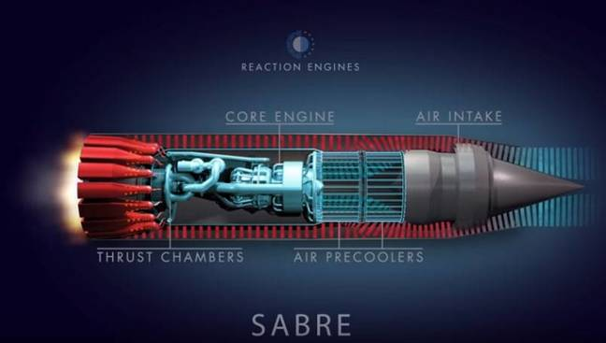
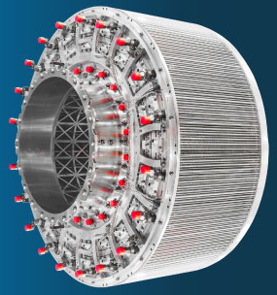
Reaction Engines and SABRE
Synergetic Air Breathing Rocket Engine (SABRE) in development for single-stage-to-orbit and hypersonic transport vehicles
Capable of Mach 5.4 in air breathing mode
Developed around key precooler technology
Notes:
Reaction engines are developing the synergetic air breathing rocket engine for single-stage-to-orbit and hypersonic transport vehicles
It will be capable or up to Mach 5.4 flight in air breathing mode and has been developed around their key precooler technology

Slide 3
Core cycle imposes RPM and Q constraint on design
Q_{in}= 2.17 m³ s⁻¹
Ω = 6782 RPM
Notes:
The core engine cycle involves five different working fluids and multiple pumps, turbines and heat exchangers
For our purposes we are only interested in the precooler, which is an air-helium heat exchanger that supplies hot helium, and the helium turbine, which is coupled to the air compressor
The precooler sets the mass flow rate and inlet pressure and temperature, giving the volumetric flow rate at turbine inlet.
The single shaft air compressor is coupled directly to the turbine without a gearbox, so it fixes the rotational speed.
These constraints limit turbine design.

Slide 4
Points to take away
Constraints imposed by other cycle components force the turbine into a biased design space dominated by shroud loss
Optimal performance is achieved through designs that reduce geometric tolerance driven loss sources
Constraints also cause the machine to have shroud gap variations of up to 25% of span during thermal transients. This is particularly bad for performance due to the sensitivity on shroud leakage.
Notes:
From the rest of this talk there are three key points that I want you to take away.
Constraints imposed by other cycle components force the turbine into a biased design space dominated by shroud loss
Optimal performance is achieved through designs that reduce geometric tolerance driven loss sources
Constraints also cause the machine to have shroud gap variations of up to 25% of span during thermal transients. This is particularly bad for performance due to the sensitivity on shroud leakage.
Keep these in mind as I show you how I’ve come to these conclusions

Slide 5
Designs produced through optimisation of mean line model
Aim
Design for minimum stages to reach 85% efficiency
Methods
Mean line with correlations
Variable parameters through the turbine
SLSQP optimisation with 5000 starting points to avoid local minima
Loss correlations used
Profile and trailing edge - Denton 1993
Secondary - Dunham and Came 1970
Shroud leakage - Denton 1993
Notes:
The core aim of this project is to design a turbine with an efficiency of 85% and as few stages as possible for mechanical simplicity
To do this I have developed a mean line design tool that uses correlations for profile, trailing edge, secondary and shroud losses to estimate turbine efficiency
The model allows for parameters to be varied for every stage through the turbine
Least squares optimisation is used with 5000 starting points to ensure a global optimum efficiency is reached

Slide 6
Shroud loss dominates, so large blade spans reduce loss
Shroud loss dominates
Design favours large blade spans
Low flow coefficient increases spans
Notes:
With the model I am able to interrogate designs to show the relative magnitude of each loss mechanism
The following graphs are based on a ten stage turbine chosen by the optimisation and vary a single parameter, showing lost work from each mechanism normalised by total turbine work
The green shaded areas represent the regions in which optimal designs lie
This first graph shows how losses change when flow coefficient is varied.
We first see that shroud loss is clearly the dominant mechanism.
The mismatch between flow rate and rotational speed results in very small blades where the fixed tolerance on the shroud gap becomes a significant fraction of the span.
Design therefore seeks as large spans as possible so mitigate this.
A low flow coefficient means lower velocities and so larger flow areas and spans that reduce shroud loss.

Slide 7
Shroud loss dominates, so large blade spans reduce loss
Shroud loss dominates
Design favours large blade spans
Low flow coefficient increases spans
Stage loading limited by profile and secondary loss
Notes:
The next graph varies stage loading coefficient.
To the left hand side shroud loss is reduced with increasing stage loading brings the radius down, which allows for larger spans.
The low flow coefficient means that high exit angles are needed to achieve the required work, and so as we move to higher loading shroud loss flattens and profile and secondary losses increases.
The optimal region for stage loading balances low profile and secondary losses with slightly higher shroud loss.

Slide 8
Shroud loss dominates, so large blade spans reduce loss
Shroud loss dominates
Design favours large blade spans
Low flow coefficient increases spans
Stage loading limited by profile and secondary loss
Low aspect ratio reduces trailing edge loss
Notes:
This graph shows variation with aspect ratio.
Aspect ratio changes the blade axial chord.
A high aspect ratio means smaller chords, reducing the impact of secondary flows, however the smaller blades have a relatively thicker trailing edge, increasing loss in the wake.
The choice of aspect ratio is a trade off between the two mechanisms.

Slide 9
Shroud loss dominates, so large blade spans reduce loss
Shroud loss dominates
Design favours large blade spans
Low flow coefficient increases spans
Stage loading limited by profile and secondary loss
Low aspect ratio reduces trailing edge loss
More stages means smaller radius, allowing thicker annulus
Notes:
Previous work has suggested the need for many stages and this final graph shows why.
Adding stages reduces the work per stage, bringing the radius down.
The subsequent increase in blade span and chord reduces both shroud and trailing edge loss.
There are no aerodynamic downsides to increasing stages, however this project seeks to reduce them for mechanical simplicity.

Slide 10
Design point changes in response to changing loss sources
Notes:
OK, this graph looks quite messy but don’t worry, I’ll explain it.
It shows how the optimal design point varies with the number of stages.
Each of these lines is formed from results of a series of optimisations at each stage number.
The solid lines show the parameter for the first stage of each design and the dashed show it for the last, with a linear variation between them

Slide 11
Design point changes in response to changing loss sources
Notes:
Flow coefficient remains pretty much constant at 0.3 in order to maintain large blade spans

Slide 12
Design point changes in response to changing loss sources
Notes:
Reaction also does not deviate from 50% as there is no reason to favour the rotor or stator

Slide 13
Design point changes in response to changing loss sources
Notes:
The grey line at the top shows the ratio of work done between the first and last stages.
The last stage does 10% more work than the first in order to unload the early stages where the higher gas density means blades spans are smaller and shroud loss is higher.

Slide 14
Design point changes in response to changing loss sources
Notes:
Stage loading increases as you move to fewer stages.
This is because as shroud loss increases the benefit of reducing the radius with a larger stage loading outweighs the penalty in profile and secondary loss.

Slide 15
Design point changes in response to changing loss sources
Notes:
Aspect ratio increases with stages.
More stages results in larger blade chords, meaning the tradeoff between secondary and trailing edge loss favours an increased aspect ratio to reduce secondary loss.

Slide 16
Design point changes in response to changing loss sources
Notes:
The result of the reduced shroud loss as you add stages is an increase in efficiency, however the benefit diminishes with more stages, with only a 1% point increase from 20 to 25 stages

Slide 17
Helium turbine operates in a biased design space compared to aeroengine turbine
Notes:
Comparing the helium turbine to a conventional aeroengine turbine demonstrates the problems faced in design.
The figure on the left shows cross-sections of the optimal 10 stage helium turbine and a representative aeroengine HP turbine taken from Cumpsty and Heyes’ study on a high bypass turbofan.
Where the helium turbine has a larger radius and blades around 1cm in span, the HP turbine has blades almost 10cm tall.

Slide 18
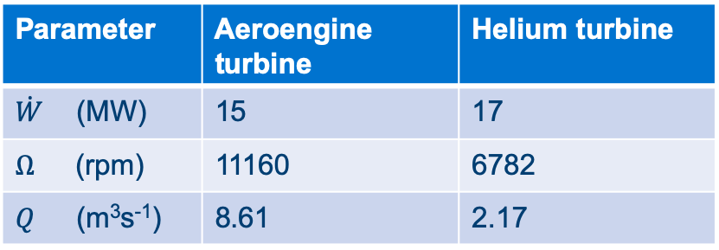
Helium turbine operates in a biased design space compared to aeroengine turbine
Parameter | Aeroengine turbine | Helium turbine
$\dot{W}$ (MW) | 15 | 17
$Ω$ (rpm) | 11160 | 6782
$Q$ (m³s⁻¹) | 8.61 | 2.17
Notes:
The table of design constraints explains the differences.
Although both have similar power outputs, the HP turbine spins 65% faster, giving it a lower radius.
The difference in inlet conditions and mass flow means the inlet volumetric flow rate for the HP turbine is 4 times larger.
This is what causes the difference in blade spans.

Slide 19
Helium turbine operates in a biased design space compared to aeroengine turbine
Parameter | Aeroengine turbine | Helium turbine
$\dot{W}$ (MW) | 15 | 17
$Ω$ (rpm) | 11160 | 6782
$Q$ (m³s⁻¹) | 8.61 | 2.17
Aeroengine turbine
Helium turbine
Notes:
The variation in turbine geometry results in a different balance between losses.
The left graph shows that at the HP turbine’s design mass flow rate loss is mostly balanced between mechanisms
The right graph shows that at its design mass flow rate the helium turbine is dominated by shroud loss.
The mass flow rate of helium would need to be 3-4 times greater to achieve this balance.
This is not possible, so the turbine is forced into a biased design space.

Slide 20
Number of stages can be reduced with tighter tolerances and improved blade and shroud design
Minimum stages for 85% efficiency with:
Notes:
I’ve shown that loss is dominated by the shroud.
So, what can be done to bring the number of stages needed for 85% efficiency down.

Slide 21
Number of stages can be reduced with tighter tolerances and improved blade and shroud design
Minimum stages for 85% efficiency with:
No changes (t_{TE} = g = 0.3mm, p/C_{x} = 1.1) | 19
Notes:
Currently, working with a trailing edge thickness and shroud gap of 0.3mm and a pitch-to-chord ratio of 1.1, 19 stages are needed

Slide 22
Number of stages can be reduced with tighter tolerances and improved blade and shroud design
Minimum stages for 85% efficiency with:
No changes (t_{TE} = g = 0.3mm, p/C_{x} = 1.1) | 19
Shroud gap halved to 0.15mm | 12
Notes:
Halving shroud clearance through tighter tolerances on machining and vibration control brings us down to a 12 stage machine.

Slide 23
Number of stages can be reduced with tighter tolerances and improved blade and shroud design
Minimum stages for 85% efficiency with:
No changes (t_{TE} = g = 0.3mm, p/C_{x} = 1.1) | 19
Shroud gap halved to 0.15mm | 12
Stator shroud loss cut by 70% | 13
Notes:
The stators aren’t rotating so they aren’t subject to the same stress limitations as the rotors
As a result a heavier, more complex shroud could be used to cut leakage dramatically
A 70% reduction in stator shroud loss would mean 13 stages are needed

Slide 24
Number of stages can be reduced with tighter tolerances and improved blade and shroud design
Minimum stages for 85% efficiency with:
No changes (t_{TE} = g = 0.3mm, p/C_{x} = 1.1) | 19
Shroud gap halved to 0.15mm | 12
Stator shroud loss cut by 70% | 13
All of the above + t_{TE}=0.15mm and p/C_{x} = 1.5 | 7
Notes:
We can also target the trailing edge by halving machining tolerance on the thickness and increasing pitch-to-chord with high lift blades.
If all of these changes are applied then a 7 stage machine becomes feasible.
Clearly there is scope for high efficiency with low mechanical complexity.
Because of the sensitivity on shroud loss it is important that we understand the mechanisms that set the clearance.
Zak Karimjee has presented his work on vibration and machining that has used designs generated by my modelling, while I have worked on thermal transients.

Slide 25
Shroud gap transients estimated using stress and heat transfer models
Turbine constructed with blade rings, with discs at each end to connect to the shaft and the casing acting as a pressure vessel
Stress limits used to size the rings, taking the varying strength of Inconel with temperature into account
Lumped heat capacity model used for transient thermomechanical analysis
Notes:
To determine the transient expansion behaviour of the turbine a model of its construction has been developed.
As shown in the figure, the turbine is constructed from blade rings stacked axially, with discs at each end to attach to the shaft and the casing acting as a pressure vessel.
Stresses from rotation and pressure are used as the limiting factors on the thickness of the rings, taking into account the varying strength of Inconel with temperature.
A lumped heat capacity model is then used for transient heat transfer analysis.

Slide 26
Transient expansion opens large shroud gaps
Notes:
This graph shows the problem with possible transient expansion during start-up of the turbine.
The y-axis is the change in shroud gap as a fraction of blade span and the x axis is time normalised by the hub’s thermal time constant.
The turbine starts off cold and stationary, with clearances as machined.
After accelerating to design speed, the turbine is still cold but the rotation has caused the hub to expand and close the gap
With a step change in helium temperature the case heats up and expands much faster than the hub, opening a large shroud gap until the hub begins to catch up.
Once both components are fully soaked to the operating temperature the final clearance is set.

Slide 27
Transient behaviour can be minimised with a thicker case
Stiffness and thermal mass of end discs results in large gaps during transient and operating conditions
Notes:
This analysis can be done for the whole turbine.
Each bar in this chart shows the maximum change in clearance at each phase of start-up for every stage of the optimal ten stage design.
Intermediate stages show similar behaviour to the previous graph, but the stiffness and thermal mass of the discs in the first and last stages means the case expands much faster and much more than the hub.
The large operating clearances seen in the red bars would make these stages extremely inefficient.

Slide 28
Warm transient behaviour improved by thickening pressure vessel
Stiffness and thermal mass of end discs results in large gaps during transient and operating conditions
Doubling case safety factor thickens it, increasing stiffness and thermal mass
Notes:
This can be countered by adding stiffness and thermal mass to the case by doubling the safety factor.
This greatly reduces the changes in the shroud gap for the first and last stages.
All intermediate stages now have a significant machined clearance into which the hub can expand.
As the cold-static condition is a negligible part of the operating envelope this clearance does not matter.
This is not a complete solution; a thorough mechanical design may look to use tapered discs and blades to reduce mass while better controlling the expansion.

Slide 29
Conclusions
Constraints imposed by other cycle components force the turbine into a biased design space dominated by shroud loss
Optimal performance is achieved through designs that reduce geometric tolerance driven loss sources
Constraints also cause the machine to have shroud gap variations of up to 25% of span during thermal transients. This is particularly bad for performance due to the sensitivity on shroud leakage.
Notes:
I hope you will agree that the evidence I have presented here backs up my conclusions stated at the start.
I have shown that:
Constraints imposed by other cycle components force the turbine into a biased design space dominated by shroud loss
Optimal performance is achieved through designs that reduce geometric tolerance driven loss sources
Constraints also cause the machine to have shroud gap variations of up to 25% of span during thermal transients. This is particularly bad for performance due to the sensitivity on shroud leakage.
Thank you for listening, any questions?

Slide 30
Core cycle imposes RPM and $\dot{Q}$ constraint on design
Limits placed on the turbine by air precooler and compressor specifications
Inlet stagnation pressure | 145 bar | 145 bar
Inlet stagnation temperature | 950 K | 950 K
Inlet stagnation density | 7.38 kg m⁻³
Mass flow rate of He | 16 kg s⁻¹ | 16 kg s⁻¹
Inlet volumetric flow rate of He | 2.17 m³ s⁻¹
Power output | 17 MW | 17 MW
Pressure ratio | 2
Rotational speed | 6782 RPM | 6782 RPM
Notes:
Cp = 5187 R = 2067

Slide 31
More stages means more blades to machine
More stages results in more blades, increased machining time
Difference between 5 and 25 stages is only 30%, not 400%

Slide 32
Reynolds essentially constant due to balance between blade size and velocity
Reynolds based on exit conditions and suction surface length
Essentially constant as fewer stages with higher velocities also have smaller blades
Re used in correlation for profile loss to vary C_{D}, which feeds into TE correlation with BL thickness

Slide 33
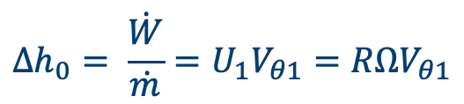
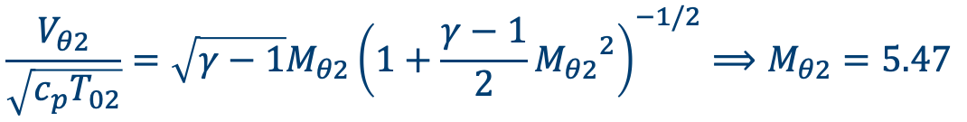

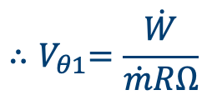
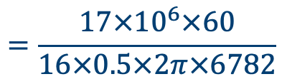
Radial turbines would have high inlet Mach number
For a single stage radial/Pelton with axial exit flow:
$$∆h_{0}= \frac{\dot{W}}{\dot{m}}=U_{1}V_{θ1}=RΩV_{θ1}$$
$${∴V}_{θ1}=\frac{\dot{W}}{\dot{m}RΩ}$$
$$=\frac{17×{10}^{6}×60}{16×0.5×2π×6782}$$
$$=2992 \text{m}{\text{s}}^{\text{−1}}$$
$$\frac{V_{θ2}}{\sqrt{c_{p}T_{02}}}=\sqrt{γ−1}M_{θ2}{\left(1+\frac{γ−1}{2}{M_{θ2}}^{2}\right)}^{−1/2}⟹M_{θ2}=5.47$$

Slide 34

Non-repeating stage angles
$α_{in}=0$º
$$α_{1,n}= α_{3,n−1}$$
$$α_{3}= \tan^{−1}\left(\frac{−2ψ+\sqrt{4ψ^{2}−4Λ(2ψΛ−φ^{2}Λ\tan^{2}{α_{1}−2ψ+ψ^{2})}}}{2φΛ}\right)$$
$$α_{2}=\tan^{−1}\left(\tan{α_{3}+ \frac{ψ}{φ}}\right)$$
$$β_{2}=\tan^{−1}\left(\tan{α_{2}− \frac{1}{φ}}\right)$$
$$β_{3}=\tan^{−1}\left(\tan{α_{3}− \frac{1}{φ}}\right)$$

Slide 35


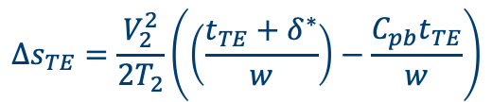
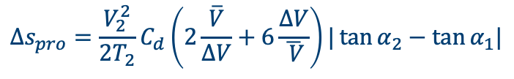

Loss correlations
Shroud leakage– Denton 1993
Profile – Denton 1993
Trailing edge – Denton 1993
Secondary – Dunham & Came 1970
$$\frac{m_{L}}{m_{m}}=\frac{gCc }{b}\sqrt{\sec^{2}{α_{2}−\tan^{2}{α_{1}}}}$$
$$Δs_{TC}=\frac{m_{l} }{m_{m}}\frac{V_{2}^{2}}{T_{2}}\left(1−\frac{\tan{α_{1}}}{\tan{α_{2}}}\sin^{2}{α_{2}}\right)$$
$$Δs_{pro}={\frac{V_{2}^{2}}{2T_{2}}C}_{d}\left(2\frac{\overline{V}}{ΔV}+6\frac{ΔV}{\overline{ V}}\right)|\tan{α_{2}−\tan{α_{1}|}}$$
$$Δs_{TE}=\frac{V_{2}^{2}}{2T_{2}}\left(\left(\frac{t_{TE}+δ^{∗}}{w}\right)−\frac{C_{pb}t_{TE}}{w}\right)$$
$$Δs_{sec}=\frac{V_{2}^{2}}{2T_{2}}×0.375×0.1336\frac{C_{x}}{b}\frac{\cos^{3}{α_{2}}}{\sqrt{\cos{α_{1}}}}\frac{({\tan{α_{1}−\tan{α_{2}})}}^{2}}{\cos{α_{m}}}$$

Slide 36





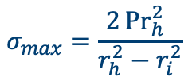

Thermomechanical equations
Inconel 718 properties
$$σ_{y}=\left(1250−e^{\frac{T−273}{128}}\right)×{10}^{6}$$
$E=166.3\left(1+ν\right)\left(1−0.5×\frac{T−300}{1673}\right)×{10}^{9}$
Stress from rotation and pressure
$$σ_{max}=\frac{ρΩ^{2}}{4}\left(\left(3+ν\right)r_{h}^{2}+\left(1−ν\right)r_{i}^{2}\right)$$
$$σ_{max}=\frac{2{Pr}_{h}^{2}{ }}{r_{h}^{2}−r_{i}^{2}}$$
Heat transfer
$$τ_{c}=\frac{ρc_{p} }{h}\left(\frac{r_{o}^{2}−r_{c}^{2}}{2r_{c}}\right)$$
$$\frac{T−T_{01}}{293−T_{01}}=e^{−t/τ}$$
$$Nu_{x,m}=0.0296Re_{x,m}^{4/5}{Pr}_{m}^{1/3}{ }$$

Slide 37

Reaction Engines: A Summary

